Slide 1

Term Project Proposal
201631513 Hwang ByungHoon
201635825 Oh SeongWon
201635841 Lee ChaeHyeon
201835437 Kim JinKyung

Slide 2
INDEX
01
Project title
02
Dataset
03
Project idea
04
Brief description
05
Team member
06
Schedule

Slide 3

Project Title
Term Project Proposal
In Classification
OR
The classification goal is to predict if the client
will subscribe a term deposit

Slide 4
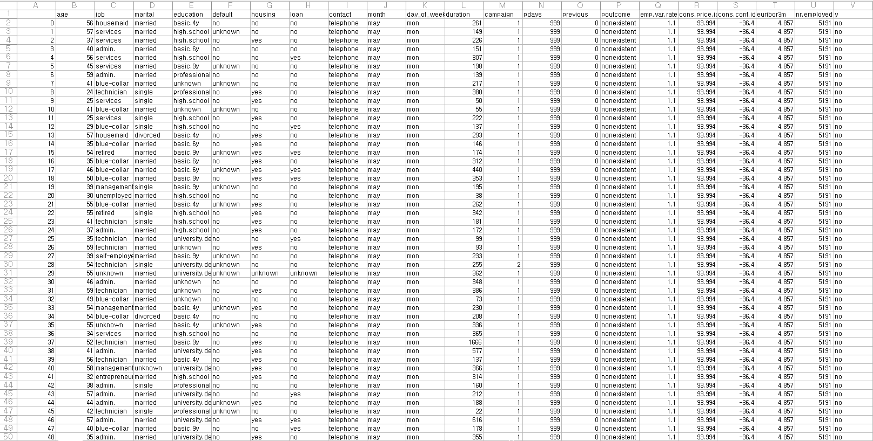
Dataset
Term Project Proposal
In Classification
File
bank-additional-full.csv
Size
21 Columns,
41147 Rows
Dataset Link
https://www.kaggle.com/henriqueyamahata/bank-marketing?select=bank-additional-full.csv

Slide 5
Dataset
Term Project Proposal
In Classification
Numeric
Categorical
Age
Duration
Campaign
Pdays
Previous
emp.var.rate
cons.price.idx
cons.conf.idx
euribor3m
nr.employed
Loan
Contact
month
day_of_week:
Poutcome
Y (target)
Job
Marital
Education
Default
Housing
“There is no null value in the data”

Slide 6
Dataset
Term Project Proposal
In Classification
Age (numeric)
→ We think the perception of deposits will vary depending on age.
Job : type of job (categorical)
→ It will have an impact because profits depend on jobs.
Default : has credit in default? (categorical)
→ Those who are credit in default will not hold deposits.
Housing : has housing loan? (categorical)
→ The loan of the house will affect deposit registration.
Loan : has personal loan? (categorical)
→ Individuals' loan status will affect deposit registration.

Slide 7
Dataset
Term Project Proposal
In Classification
Emp.var.rate : employment variation rate - quarterly indicator (numeric)
Cons.price.idx : consumer price index - monthly indicator (numeric)
Cons.conf.idx : consumer confidence index - monthly indicator (numeric)
Euribor3m : euribor 3 month rate - daily indicator (numeric)
Nr.employed : number of employees - quarterly indicator (numeric)
Economic conditions can affect people's enrollment in deposits.

Slide 8
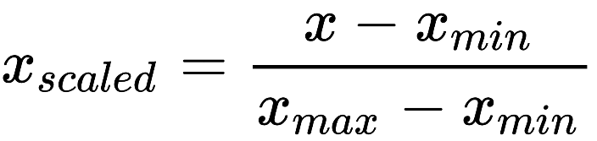
Data Preprocessing
Term Project Proposal
In Classification
1. Outlier Data detection
2. Feature Scaling
→ min-max normalization
3. Splitting the Training and Test set
→ Cross validation

Slide 9
Brief Description
Term Project Proposal
In Classification
Algorithm
KNN
SVM
Decision Tree
Random Forest
GradientBoostingClassifier
XGBClassifier
GaussianNB

Slide 10

Project Title
Term Project Proposal
In Clustering
The clustering goal is to show how each country's population changes over time.

Slide 11


Project Idea
Term Project Proposal
In Clustering
By clustering the indicator dataset, we analyze how the population has changed by year.
It also visualizes these results by displaying them on a map.

Slide 12
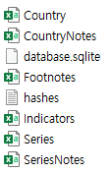
Dataset
Term Project Proposal
In Clustering
Has 6 csv Files
Explore country development indicators from around the world
Dataset Link
https://www.kaggle.com/worldbank/world-development-indicators

Slide 13
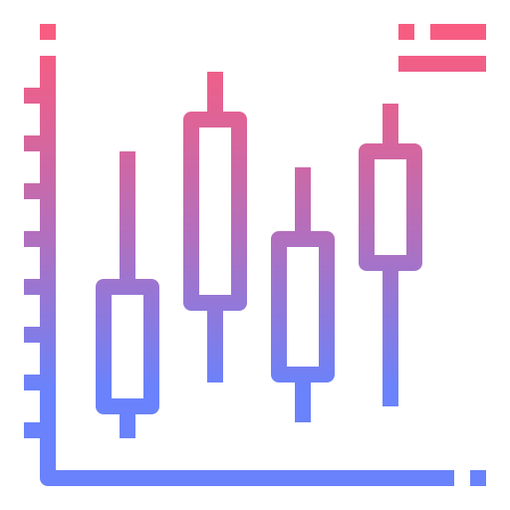

Brief Description
Term Project Proposal
In Clustering
Use 3 Machine Learning Algorithms – K Means, DBSCAN, EM
We will use the best of the three algorithms
Evaluation
Visualization using PCA

Slide 14
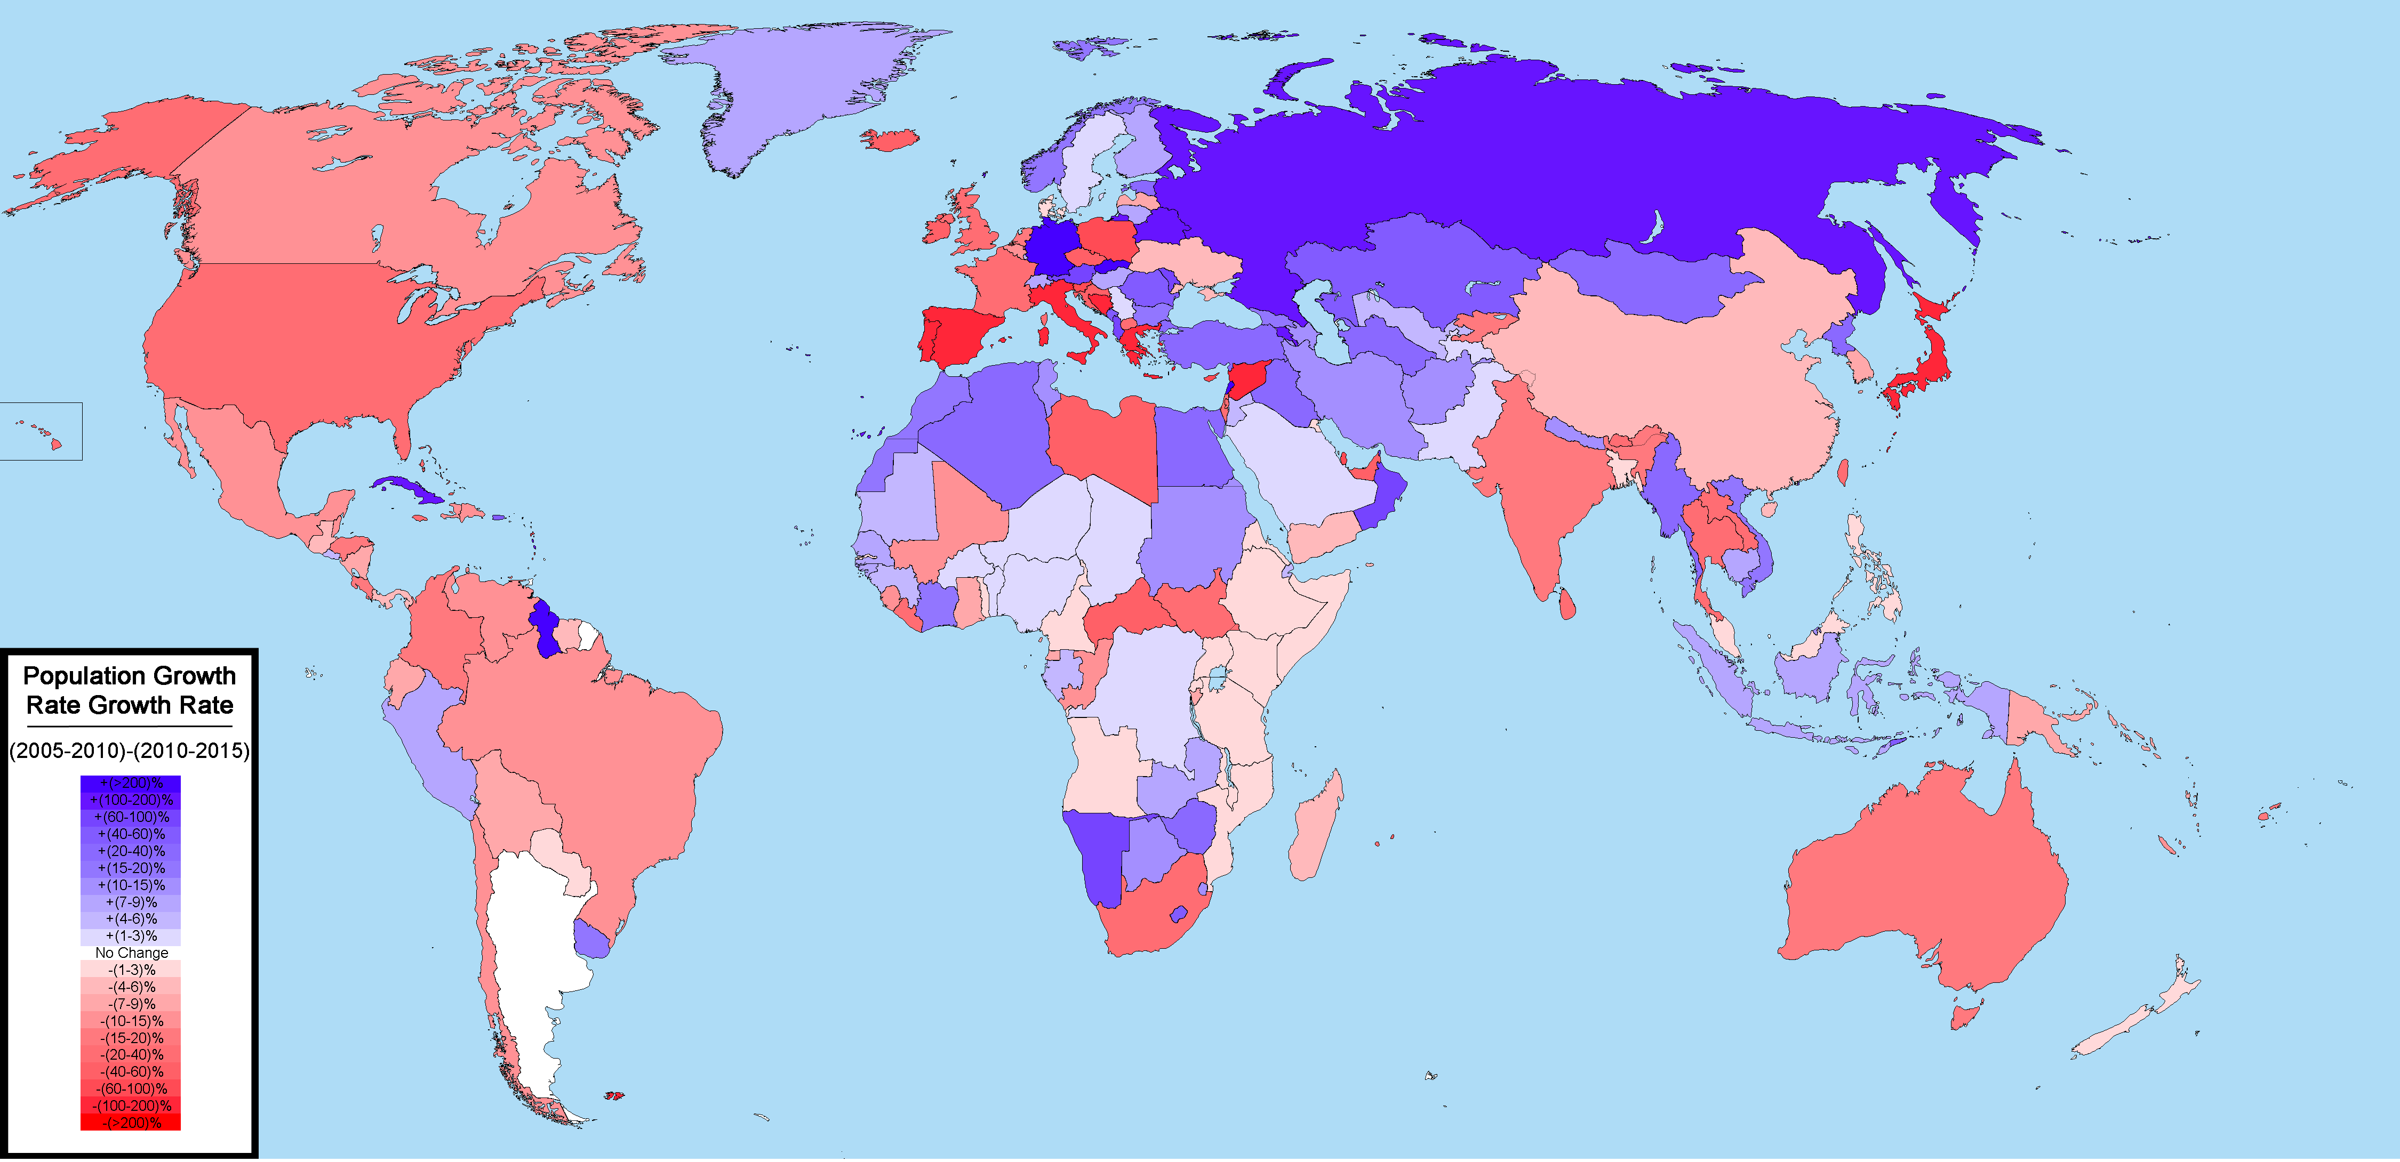
Brief Description
Term Project Proposal
In Clustering
The world's population growth is expressed in colors on the map by year

Slide 15




Team member
Term Project Proposal
Hwang ByungHoon
Student ID
201631513
Email
byunghoonhwang97 @gmail.com
Oh SeongWon
Student ID
201635825
Email
tjddnjs970325@gmail.com
Lee ChaeHyeon
Student ID
201635841
Email
lch50484084@gmail.com
Kim JinKyung
Student ID: 201835437
Email
lxsz987@gmail.com

Slide 16
Schedule
Term Project Proposal
Sun | Mon | Tue | Wed | Tur | Fri | Sat
11/1 | 11/2 | 11/3 | 11/4 | 11/5 | 11/6 | 11/7
11/8 | 11/9 | 11/10 | 11/11 | 11/12 | 11/13 | 11/14
11/15 | 11/16 | 11/17 | 11/18 | 11/19 | 11/20 | 11/21
11/22 | 11/23 | 11/24 | 11/25 | 11/26 | 11/27 | 11/29
11/29 | 11/30 | 12/1 | 12/2 | 12/3 | 12/4 | 12/5
Data Curation / Data Inspection
Data Preprocessing
Data Analysis (Classification)
Data Analysis (Clustering)
Evaluation / Deployment
Prepare Final Presentation
Final Presentation
Prepare Final Presentation

Slide 17
Thank You
Term Project Proposal

